Slide 1
Mario Pyramid (Worlds) in Greenfoot
By Derek Peacock

Slide 2
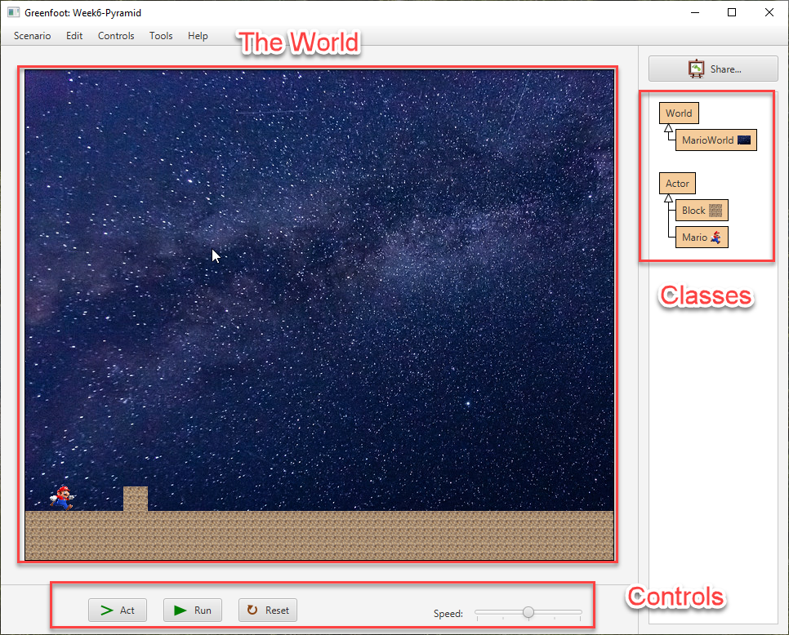
The Greenfoot System
MarioWorld is a kind of World
Mario is a kind of Actor
Block is a kind of Actor

Slide 3
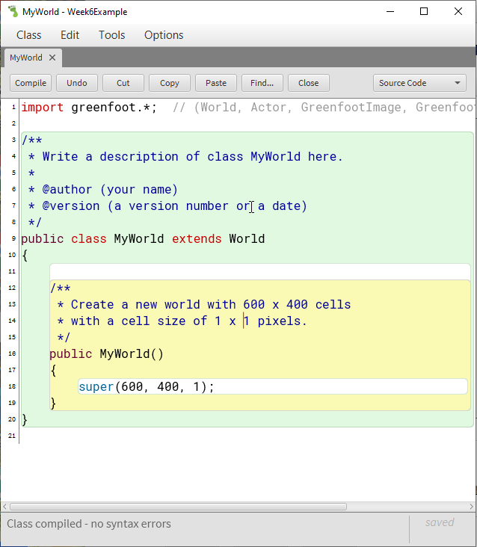
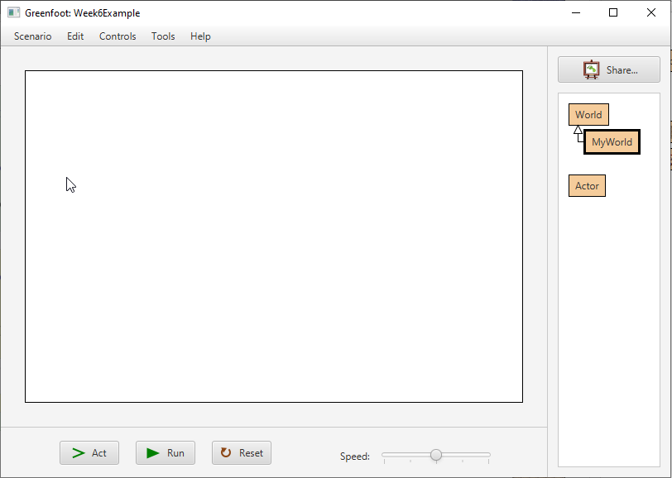
Starting a new Greenfoot Project

Slide 4
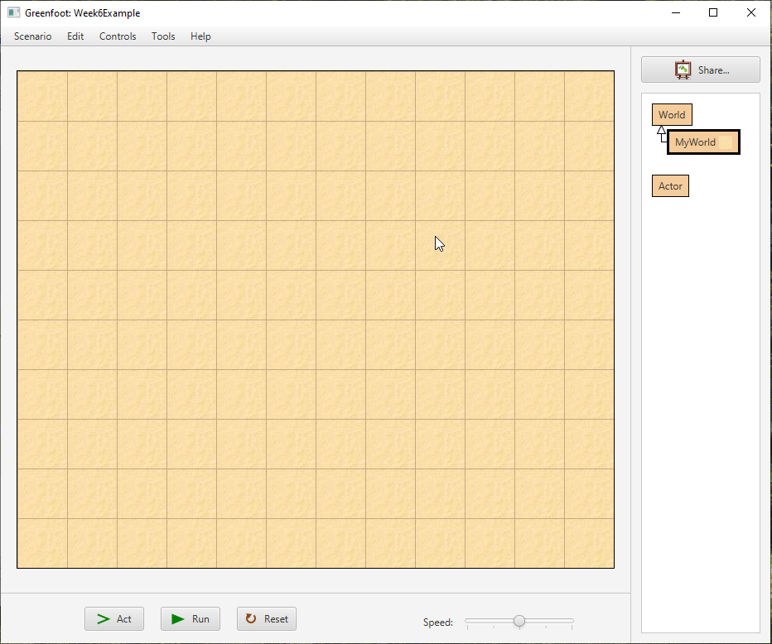
Setting up the World
Right click on MyWorld and select an appropriate image.
The cells in this image do not match the cells in the world!!
It is just a background image!

Slide 5
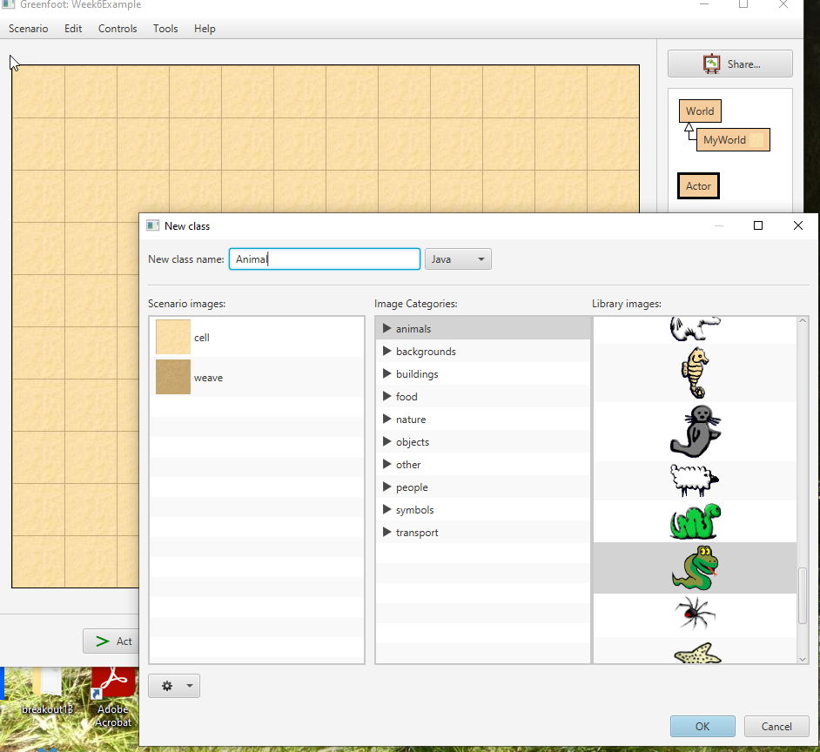
Adding an Actor
Right click on Actor and Add a Subclass
Give it a class name
Select an image

Slide 6
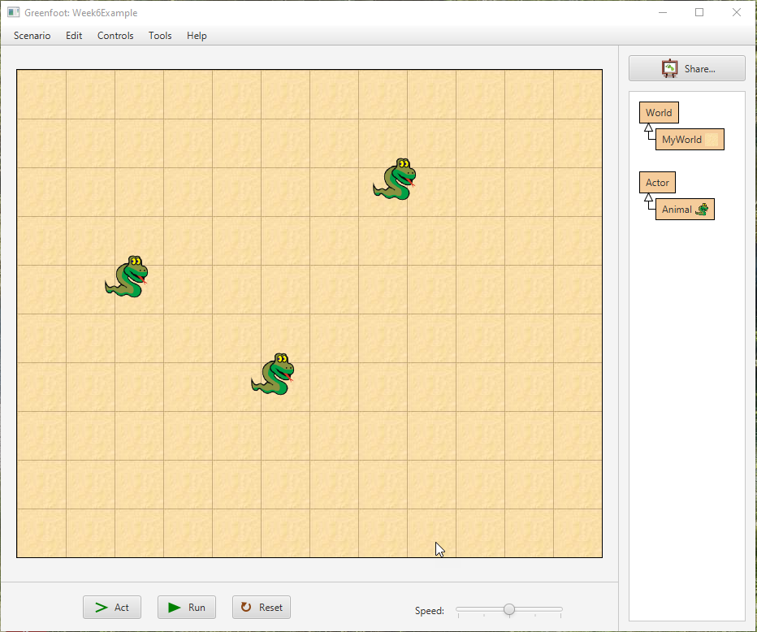
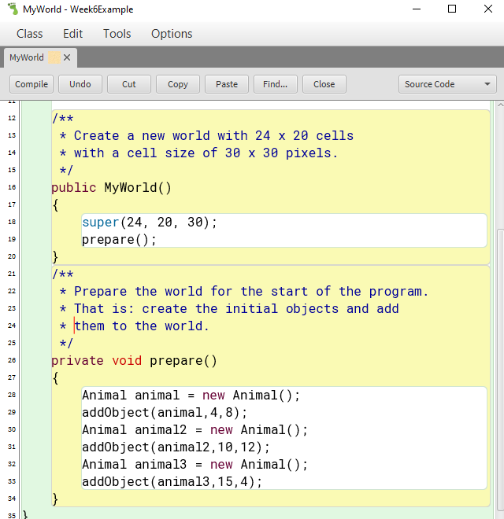
Creating an instance of the Actor
Right click on the Animal class and select New Animal
You can have as many instances of the Animal as you like
If you want to arrange a world this way goto Tools -> Save the World

Slide 7
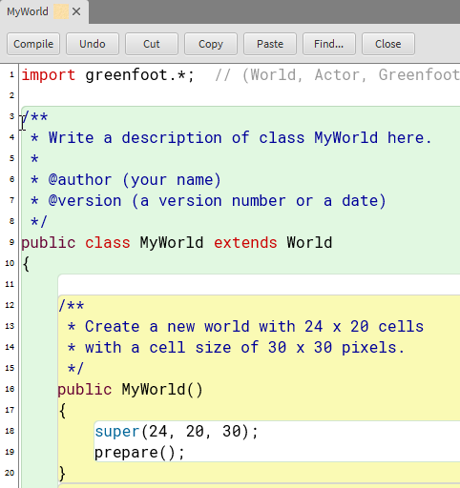
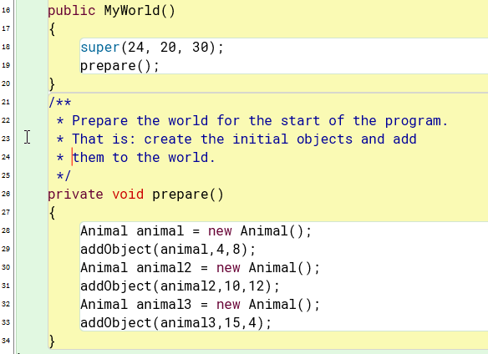
The World has been saved!!!
I would name the method setup() or setupAnimals()

Slide 8
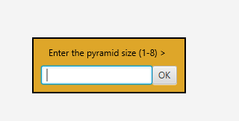
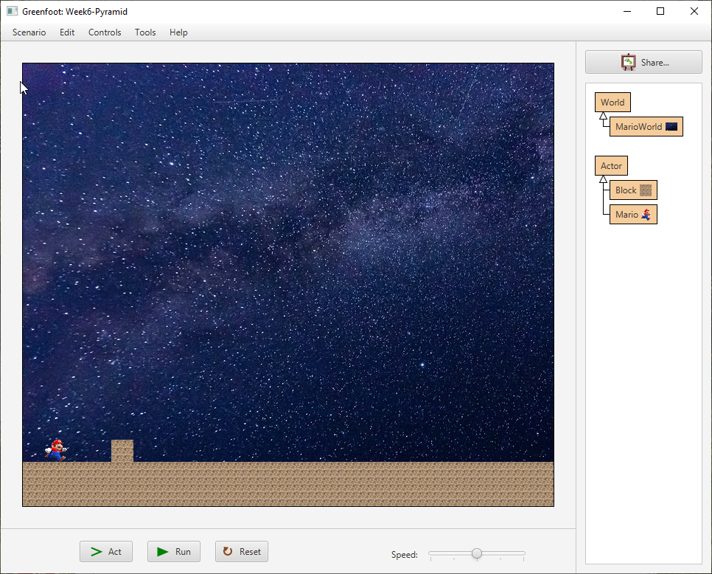
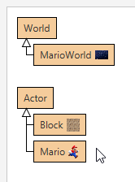
Your Starter for 10

Slide 9
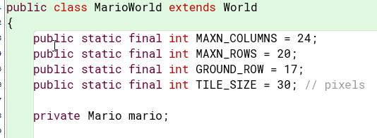
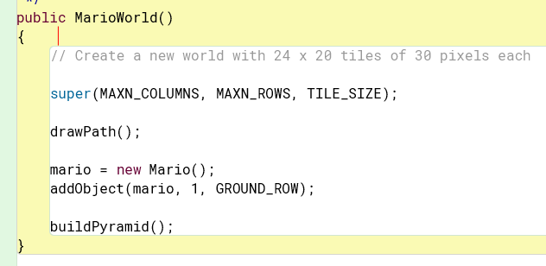
Starting Code

Slide 10
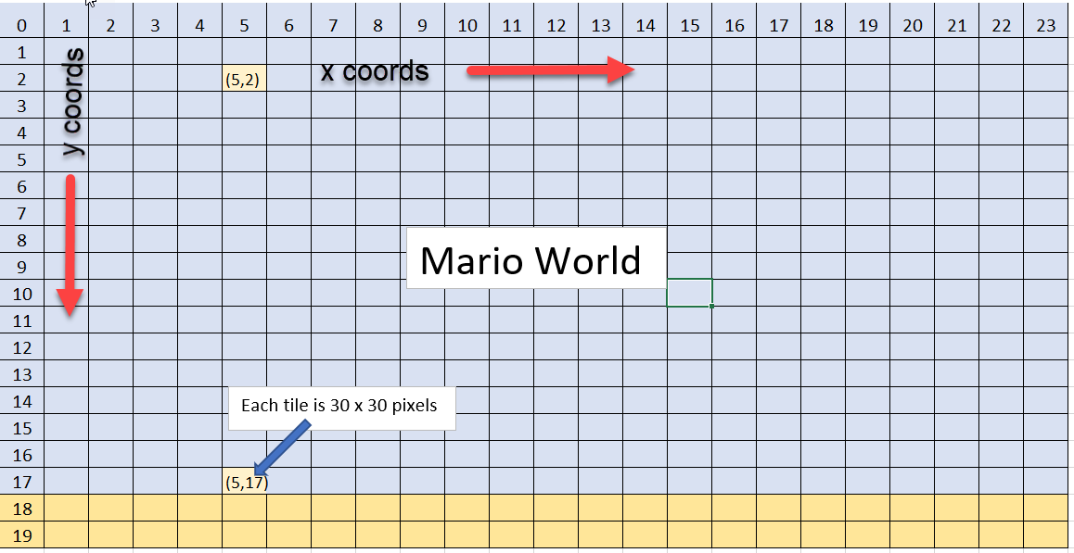
2D Coordinates (x, y)

Slide 11
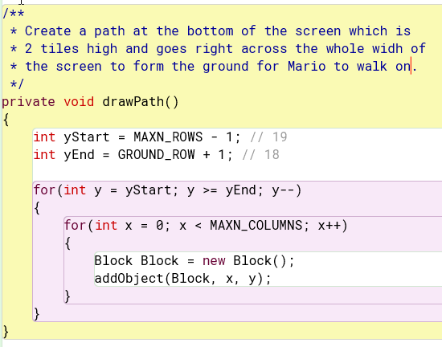
drawPath()
Start at the bottom row of the screen and work upwards row by row and column by column

Slide 12
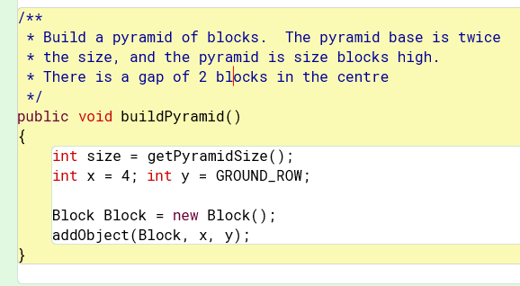
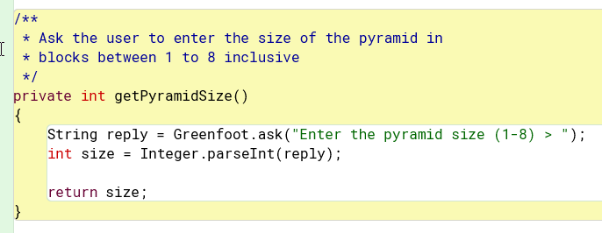
buildPyramid()
Refactor getSize() so that it only returns valid values.
Refactor build pyramid so that it can be built anywhere on the ground.
Build one side of the pyramid
Build the other side

Slide 13
Using GitHub with Greenfoot
Greenfoot does not know about Git or GitHub
There are three Greenfoot Projects inside
Java-Apps
Use GitHub Desktop to save any changes to the Greenfoot projects
Open the whole repository in GitHub Desktop

Slide 14
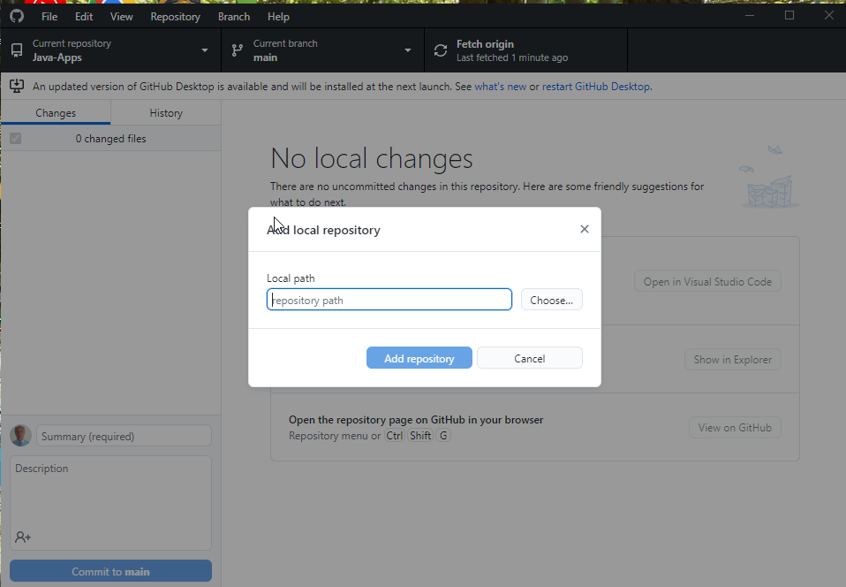
Add Repository to GitHub Desktop

Slide 15
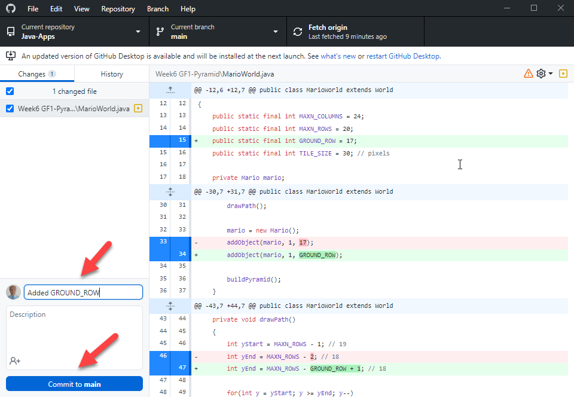
Commit Changes to main
Main refers to the one and only git branch

Slide 16
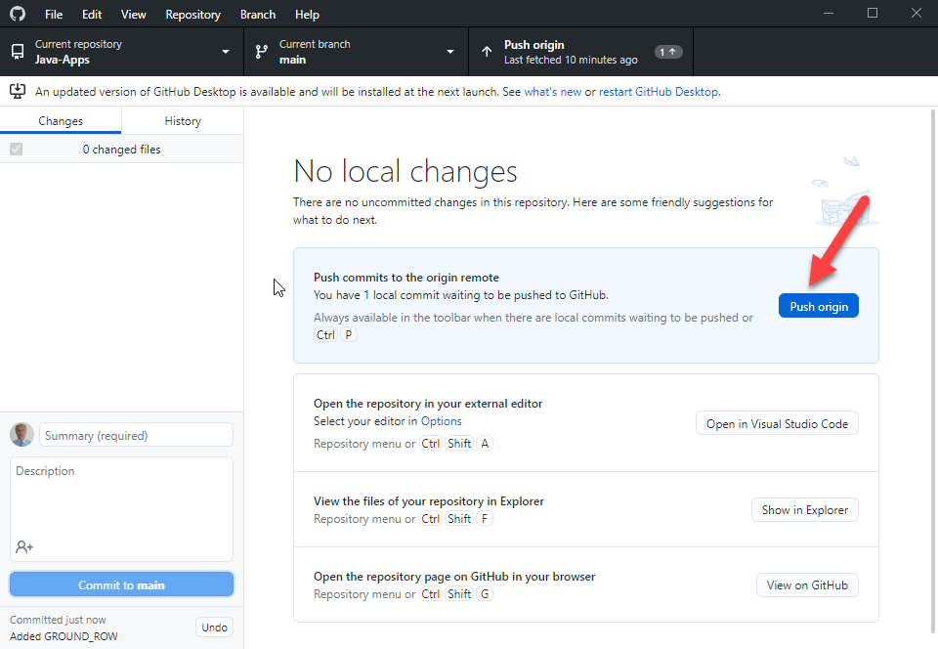
Push origin

Slide 17

Greenfoot Videos
https://www.greenfoot.org/doc
https://www.youtube.com/user/18km

Slide 18
Summary
Greenfoot can be used to create 2D Java games easily
Greenfoot Worlds contain background images and Actors
Actors can be created and placed in the World using (x, y) cords
Actors will act() i.e. move around and do things.

Slide 19
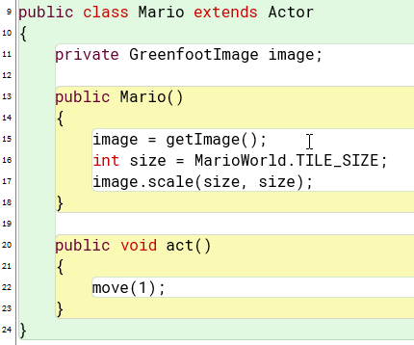
Actor.act()
Mario is set to the same size as a tile
When the app is run
The act() method is called 30/sec.
Mario moves 1 tile each time
Mario goes straight through any blocks
Intelligent movement and collision detection need adding.

Slide 20
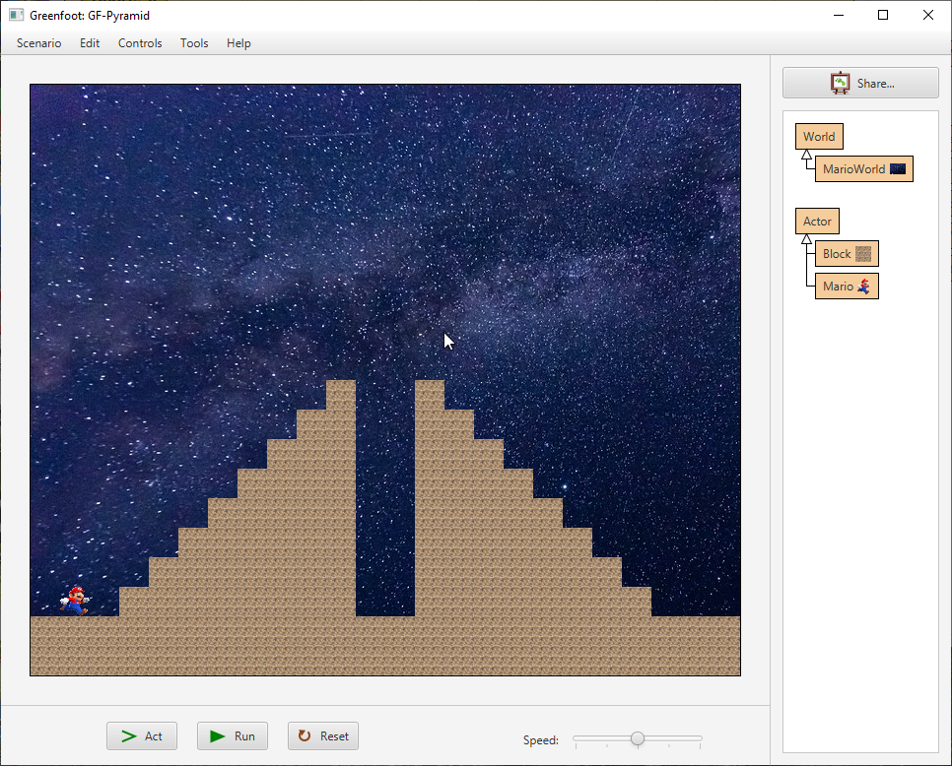
Practical Exercises
Draw a half pyramid of fixed size
Change it so that it is of variable size
Draw both half pyramids of variable size
Can you get Mario to move??
Can you get Mario to stop when he hits a block
Where can you go to find out what other methods are available?

